Slide 1
STAYZE RENT PREDICTION
Presented by:
Omkar Asukar
Durgesh
Mandar Vast
Durvesh Tambe

Slide 2
BUSINESS PROBLEM
To set up ideal prices for the properties listed on the website.
To provide meaningful insights to the stakeholders based on the available data for the properties listed.
To understand the customer and hosts behavioural patterns.

Slide 3
BUSINESS IMPACT
To increase revenue for the company and improve customer satisfaction by setting up ideal prices for the properties listed on the website.
To make business decisions and guide marketing initiatives.
To tailor the additional services using targeted campaigns based on behavioural insights of travellers and hosts.

Slide 4
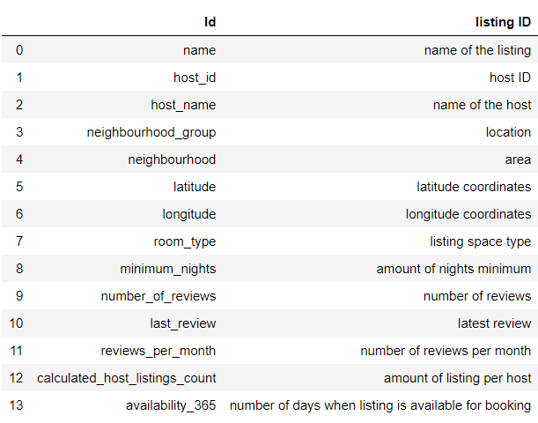
OVERVIEW OF DATA
The dataset consists of 15 columns out of which 14 columns shown in the figure to the right are the feature variables and the target variable is price (the variable we have to predict)

Slide 5
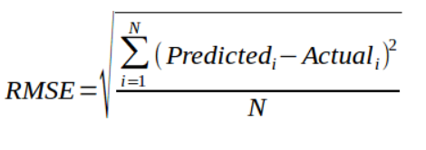
EVALUATION METRIC
ROOT MEAN SQUARED ERROR :
The Root Mean Square Error (RMSE) is a frequently used measure of the difference between values predicted by a model and the values actually observed from the environment that is being modeled.
RMSE severely punishes large differences in prediction. This is the reason why RMSE is powerful as compared to Absolute Error.
Evaluating the RMSE and tuning our model to minimize its results in a more robust model.

Slide 6
FIRST STEPS EDA
1
Let’s start with the first set of Visualizations

Slide 7
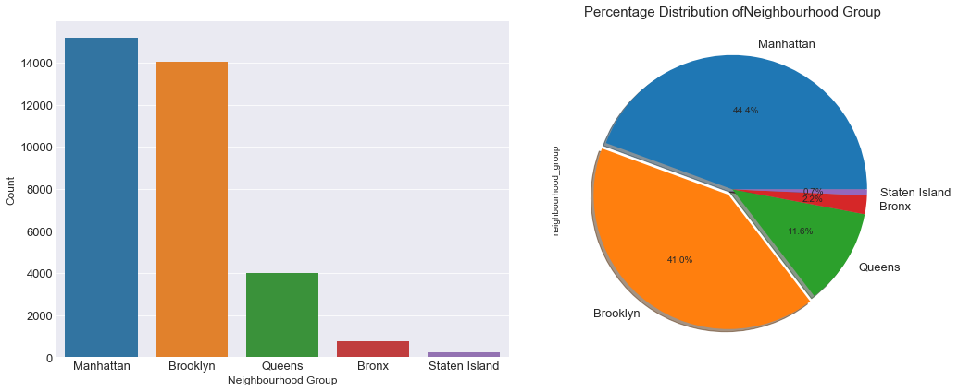
Neighbourhood Group with maximum no of Listings
Manhattan and Brooklyn are densely populated cities and get more number of guests. Hence, the high number of listings.

Slide 8
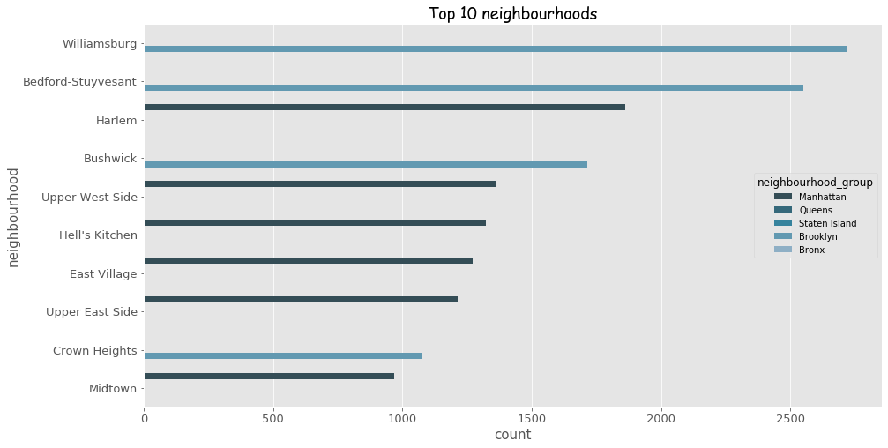
Top 10 Neighbourhoods with maximum listings

Slide 9
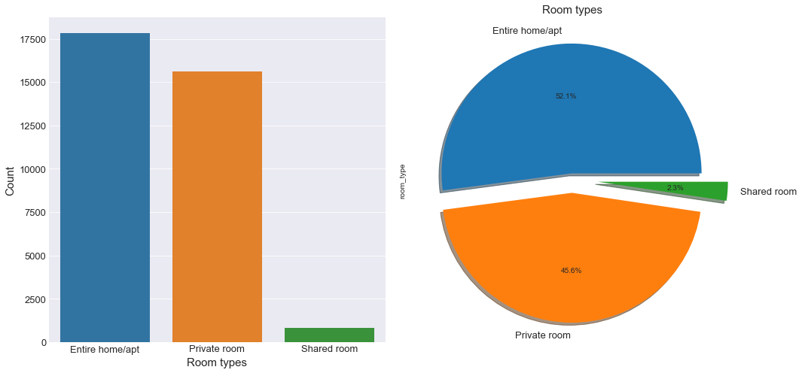
Room Types Available
Privacy issues
Shared Bathroom

Slide 10
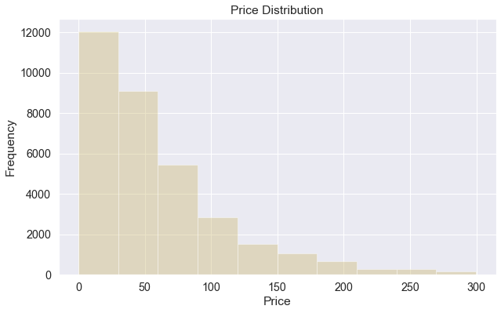
Price Distribution for the Listings

Slide 11
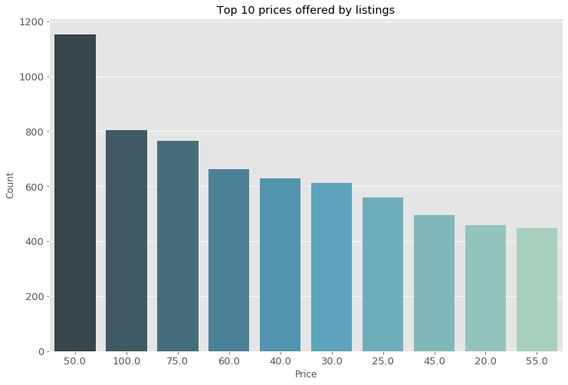
Top 10 Prices for the rooms

Slide 12
BIVARIATE EDA
2
Let’s start with the second set of Visualizations

Slide 13
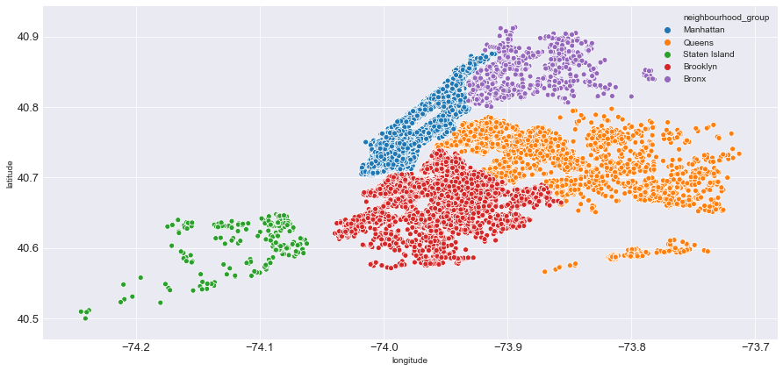
Room Distribution across the 5 Boroughs
Though the area for Manhattan is smaller than Queens and Brooklyn, it has the highest number of listings.
There are a lot of places to go sightseeing in Manhattan and thus there are a high number of listings here.

Slide 14
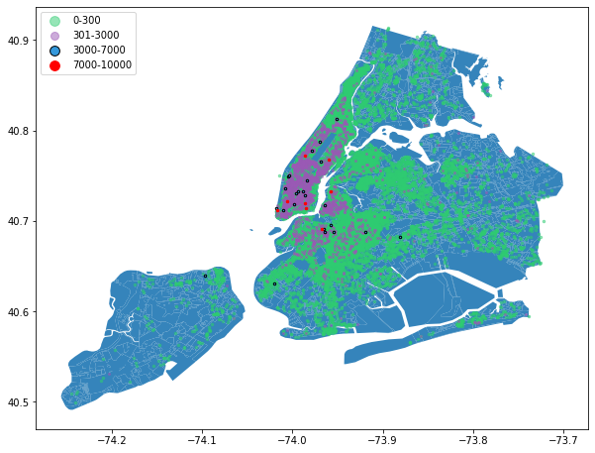
Price Distribution of Listed Properties
Majority of the listing are priced less than 300 dollars.
Majority of medium priced listings from 300 to 3000 $ are in Manhattan
14

Slide 15
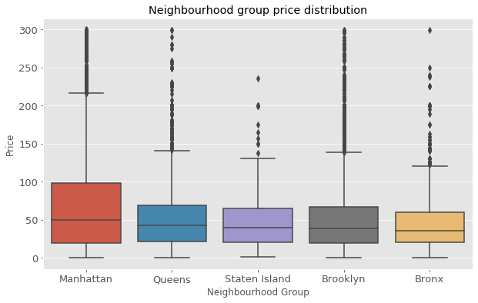
Price Distribution across the 5 Boroughs
The prices per night in Manhattan have a much higher range than the remaining neighbourhoods. This is due to the higher demand of rooms in Manhattan.
The other neighbourhoods price per night are almost equal

Slide 16
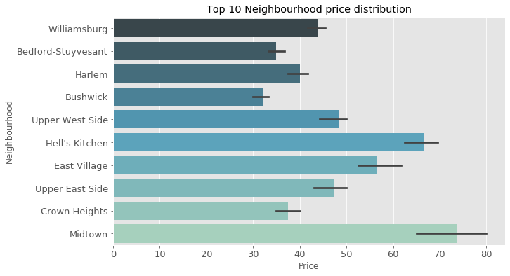
Price Distribution for Top 10 neighbourhoods
These neighbourhoods have the highest number of listings and are priced at a range of 30$ to 80$ offering cheaper stays and attracting majority of the guests.

Slide 17
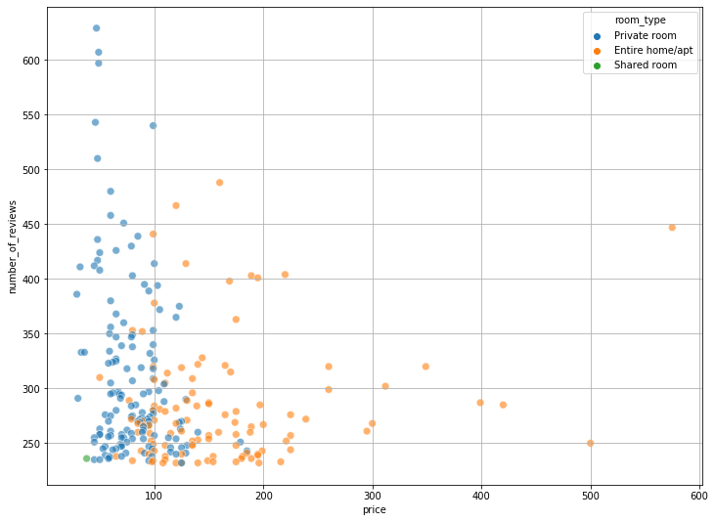
Property prices with respect to number of reviews
Properties with higher number of reviews are generally priced lower.
17

Slide 18
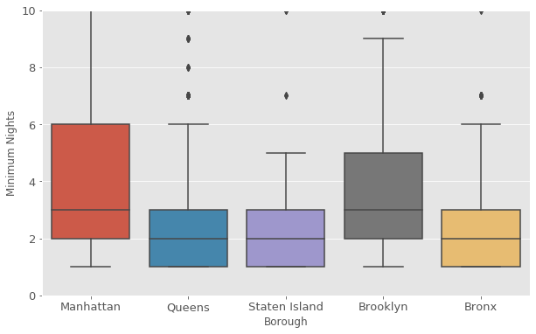
Minimum Nights in Different Neighborhoods
We could toggle with minimum night stays based on the market demand, seasonality and upcoming events.
For ex, for Manhattan the average minimum nights is 3 which can be toggled with based on the market demand.

Slide 19
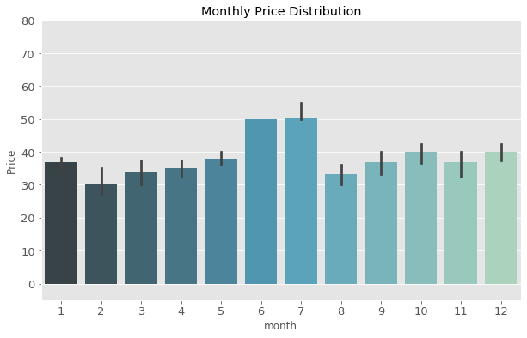
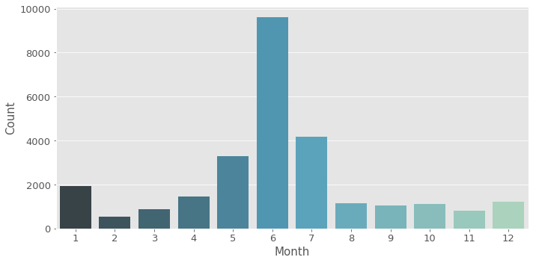
Price Distribution for different months.
April to June month have a high number of listings being booked.
14 hours or more of daylights to do more sightseeing during these months.
Introduce Dynamic pricing of rooms available depending on the market demand.

Slide 20
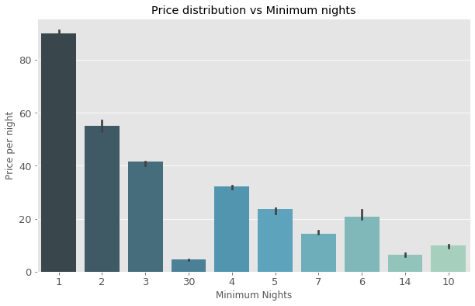
Price with respect to minimum nights
Rooms with higher minimum nights have significantly lower priced per night.
Marketing a 3 night stay at the same room would have a win-win situation for the hosts as well as the guests.
Managing a single guest for a 5 day stay is much better than managing 5 different guests for 5 single night stays.
Reduces the room maintenance cost for the host

Slide 21
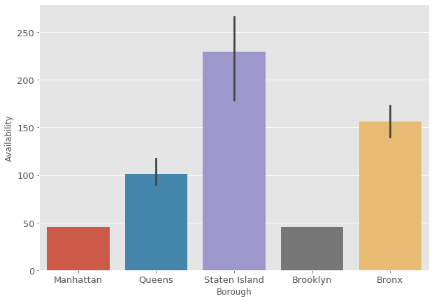
Availability of Listings in Different Neighborhoods
Though Manhattan and Brooklyn have a high number of listings they are available for very less days averaging less than 50.
We could focus on improving availability for these two boroughs as these two have a high number of guests
.
Also, make the listings available during the months of June and July.

Slide 22
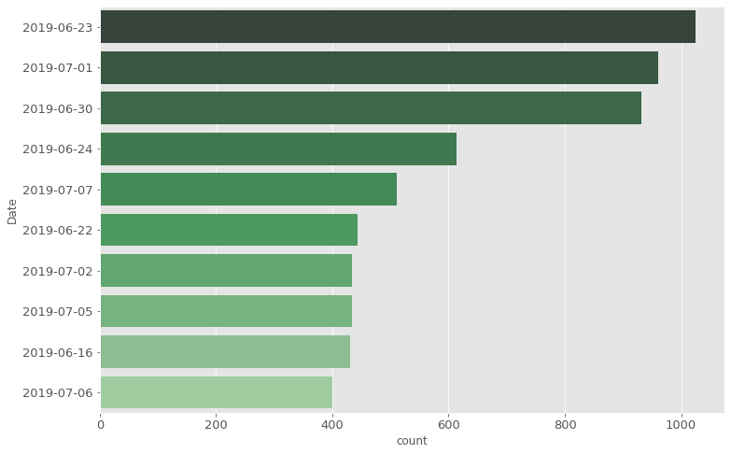
Top 10 days when maximum listings were booked
June is the LGBT Pride Month.
NYC hosted the largest international celebration of LGBT pride in history in 2019 and hence the number of guests significantly increased in the month of June

Slide 23
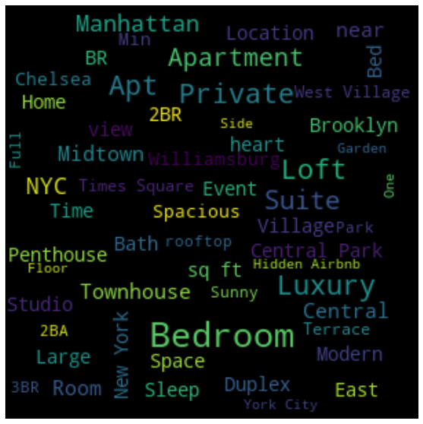
EXPENSIVE LISTINGS
Words used to describe Expensive Listings:
Central Park and Times Square
Manhattan and Brooklyn boroughs
Duplex, Suite, Penthouse, Townhouse Garden, Spacious, rooftop, Luxury
2 BR and 3 BR apartments
Williamsburg, West Village, Midtown

Slide 24
PIPELINE
3
Let’s start with Pre-processing

Slide 25
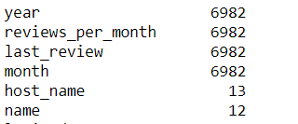
MISSING VALUES
Last review column was used to create two more column of month and years.
Reviews per month was filled with zero.
Last review was filled with 20/4/2010

Slide 26
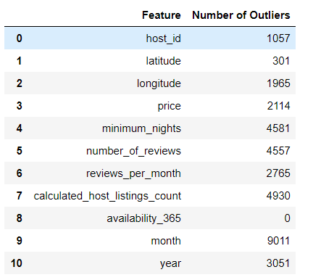
OUTLIER TREATMENT
Winsorization was used to treat outliers in all the columns.

Slide 27
FEATURE SELECTION
Following methods were used for feature selection :
Using Random Forest
Correlation Coefficient
After estimating Pearson Correlation coefficients between continuous features, following features were dropped - number of reviews

Slide 28
MODELLING
4
Let’s start with Model Building

Slide 29
Models and Approaches
Models | Mean | RMSE
Linear Regression | 153 | 214.91
Random Forest | 153 | 213.74
XGBoost | 153 | 214.86

Slide 30
Model Tuning
After performing hyperparameter tuning using Grid Search, the following results were observed.
Models | RMSE
Lasso | 222.91
Ridge | 219.86
Random Forest | 212.36
XGBoost | 213.85
30

Slide 31
BUSINESS INSIGHTS FOR STAKEHOLDERS
Increase the availability in Manhattan and Brooklyn.
Make the rooms available for the months of June and July as number of bookings increase significantly during these months:
- Good weather conditions
- Annual events like Puerto Rican day parade and LGBTQ Pride week
- Jobs.

Slide 32
What more problems we can solve?
Identify hotspot destination based on nearby place to visit.
Identify events and festivals happening around the city to attract travellers and make rooms available during this period.
Identify nearby work locations.

Slide 33
THANKS!

